Slide 1

Problem Solving Using Search
IT426: Artificial Intelligence
First Semester 1443-1444
Information Technology Department

Slide 2
SEARCH
Genetic Algorithm

Slide 3
Stochastic search: Genetic Algorithms (GAs)
GAs emulate ideas from genetics and natural selection and can search potentially large spaces.
Successors in this case are generated by combining two parent states rather than modifying a single state.
Genetic algorithms starts with a set of k randomly generated states called Population
Each state or individual is represented as a string over a finite alphabet. It is also called chromosome.

Slide 4
Genetic Algorithms - Overview
Developed: USA in the 1970’s
Early names: J. Holland, K. DeJong, D. Goldberg
Typically applied to:
Discrete optimization
Features:
Not too fast
Good heuristic for combinatorial problems
Special Features:
Traditionally emphasizes combining information from good parents (crossover)
The Quality of result depends on the Parent fitness function

Slide 5
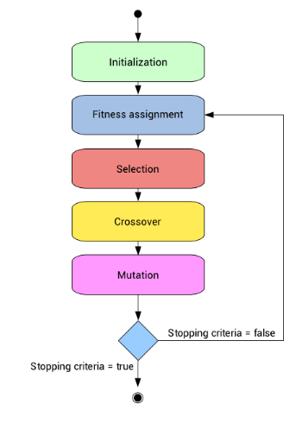
Genetic Algorithms (GAs)
Before we can apply Genetic Algorithm to a
problem, we need to answer:
How is an individual represented?
What is the fitness function?
How are individuals selected?
How do individuals reproduce?
https://www.neuraldesigner.com/blog/genetic_algorithms_for_feature_selection

Slide 6
Genetic Algorithms (GAs)
Each state is rated by the evaluation function called fitness function.
Fitness function should return higher values for better states.
For reproduction, individuals are selected with a probability which is directly proportional to the fitness score.
For each pair to be mated, a crossover point is randomly chosen from the positions in the string.
The offspring themselves are created by crossing over the parent strings at the crossover point.
Mutation is performed randomly with a small independent probability.

Slide 7
Simple Genetic Algorithms (SGA)
Holland’s original GA is now known as the simple genetic algorithm (SGA)
Other GAs use different:
Representations
Mutations
Crossovers
Selection mechanisms

Slide 8
SGA Techniques - Summary
Representation | Binary strings
Recombination | N-point or uniform
Mutation | Bitwise bit-flipping with fixed probability
Parent selection | Fitness-Proportionate
Survivor selection | All children replace parents
Speciality | Emphasis on crossover

Slide 9
SGA Representation
Phenotype space
Genotype space = {0,1}^{L}
Encoding
(representation)
10010001
10010010
010001001
011101001
Decoding
(inverse representation)

Slide 10
SGA Reproduction Cycle
Select parents for the mating pool
(size of mating pool = population size)
Shuffle the mating pool
For each consecutive pair, apply crossover with probability p_{c}
Otherwise copy parents
For each offspring, apply mutation
(bit-flip with probability p_{m} independently for each bit)
Replace the whole population with the resulting offspring

Slide 11
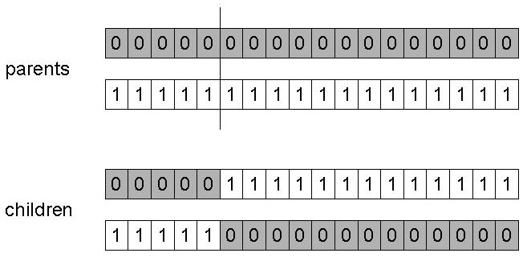
SGA Operators: 1-point Crossover
Choose a random point on the two parents
Split parents at this crossover point
Create children by exchanging tails
P_{c} typically in range (0.6, 0.9)

Slide 12
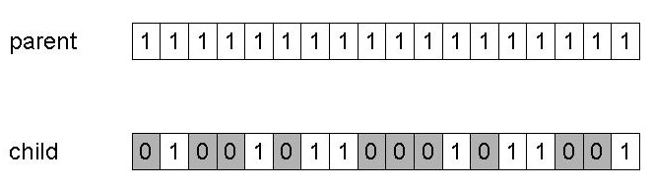
SGA Operators: Mutation
Alter each gene independently with a probability p_{m}
p_{m} is called the mutation rate
Typically between 1/pop_size and 1/ chromosome_length

Slide 13
SGA Operators: Selection
Main idea: better individuals get higher chance
Chances proportional to fitness
Implementation: roulette wheel technique
Assign to each individual a part of the roulette wheel
Spin the wheel n times to select n individuals
1/6 = 17%
B
fitness(A) = 3
A
C
fitness(B) = 1
3/6 = 50%
2/6 = 33%
fitness(C) = 2

Slide 14
GA Example (1)
Simple problem: max x² over {0,1,…,31}
GA approach:
Representation: binary code, e.g. 01101 ↔ 13
Population size: 4
1-point xover, bitwise mutation
Roulette wheel selection
Random initialization
We show one generational cycle done by hand

Slide 15
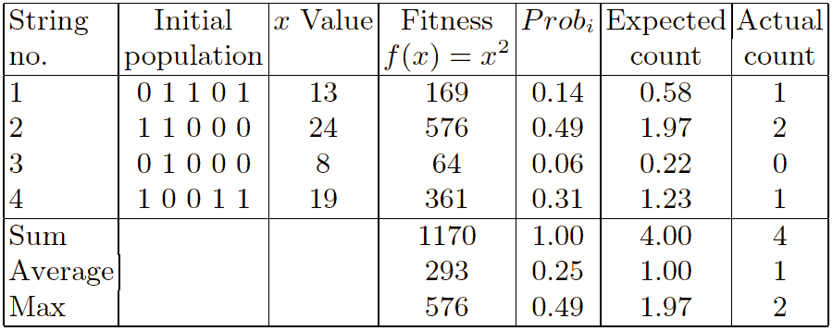
X² Example: Selection
Notes:
Normalize Prop = fitness value \ sum
Expected count = no. of pop * prop.
Actual ?

Slide 16
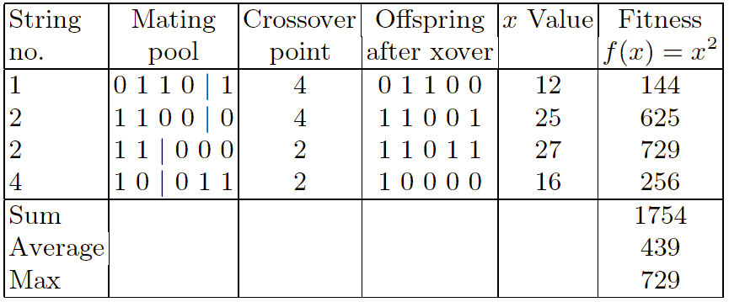
X² Example: Crossover

Slide 17
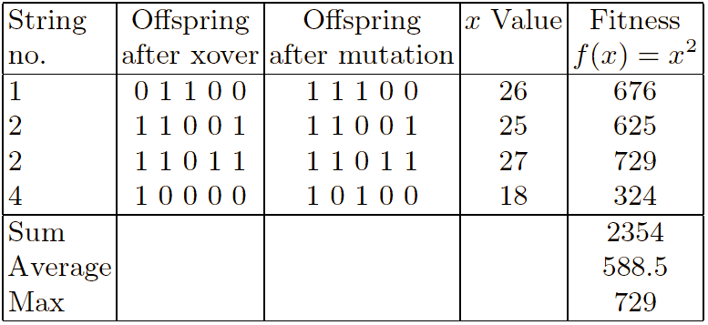
X² Example: mutation

Slide 18
Summary of SGA Process
Select the initial population (usually randomly).
Select percent probability of the following:
Crossover (often 0.6-0.8)
Mutation (often about .001).
Calculate the fitness value for each population member.
Normalize fitness values and use to determine probabilities for reproduction.
Reproduce new generation with the same number of members, using probabilities from 3.
Pair off strings to cross over randomly.
Select crossing sites (often 2) randomly for each pair.
Mutate on a bit-by-bit basis.
If more generations, go to step 3.
If completed, stop and output results.

Slide 19
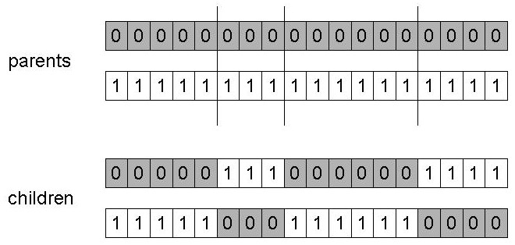
n-Point Crossover
Choose n random crossover points
Split along those points
Glue parts, alternating between parents
Generalization of 1 point (still some positional bias)

Slide 20
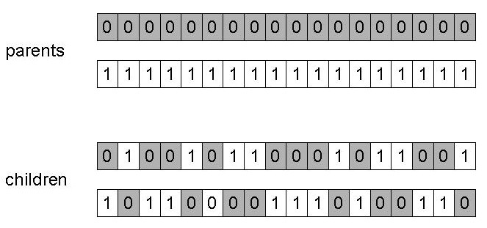
Uniform Crossover
Assign 'heads' to one parent, 'tails' to the other
Flip a coin for each gene of the first child
Make an inverse copy of the gene for the second child
Inheritance is independent of position
Notes:
?

Slide 21
Crossover OR mutation?
Answer: depends on the problem, but
In general, it is good to have both
both have another role
Mutation-only-Evolutionary Algorithm (EA) is possible, xover-only-EA would not work

Slide 22
Crossover OR mutation?
Exploration: Discovering promising areas in the search space, i.e. gaining information on the problem
Exploitation: Optimising within a promising area, i.e. using information
There is co-operation AND competition between them
Crossover is explorative, it makes a big jump to an area somewhere “in between” two (parent) areas
Mutation is exploitative, it creates random small diversions, thereby staying near (in the area of ) the parent

Slide 23
Crossover OR mutation?
Only crossover can combine information from two parents
Only mutation can introduce new information (alleles)
Crossover does not change the allele frequencies of the population
To hit the optimum you often need a ‘lucky’ mutation

Slide 24
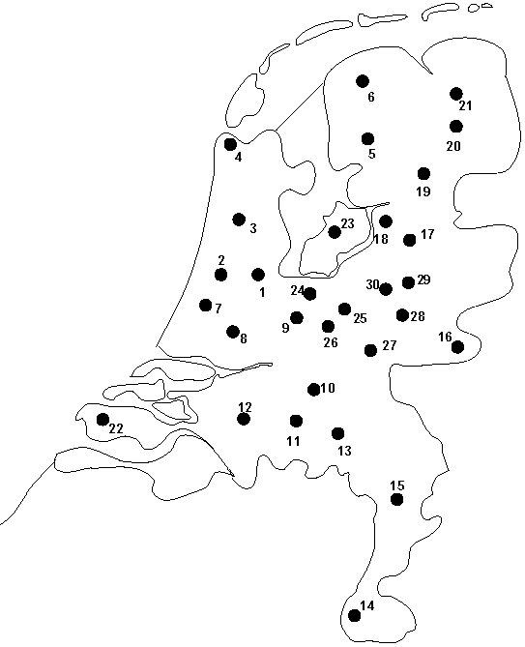
Permutation representation: TSP example
Problem:
Given n cities
Find a complete tour with minimal length
Encoding:
Label the cities 1, 2, … , n
One complete tour is one permutation
(e.g. for n =4 [1,2,3,4], [3,4,2,1] are OK)
Search space is BIG:
for 30 cities there are 30! ≈ 10³² possible tours

Slide 25
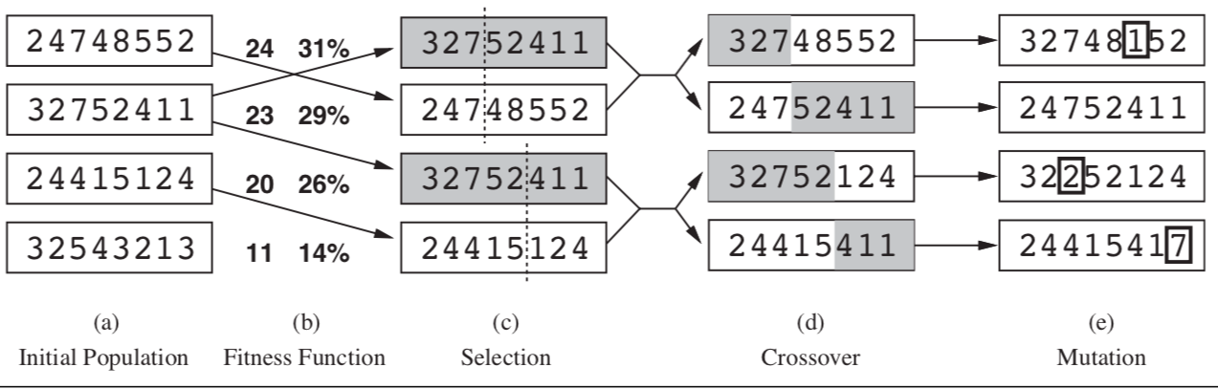
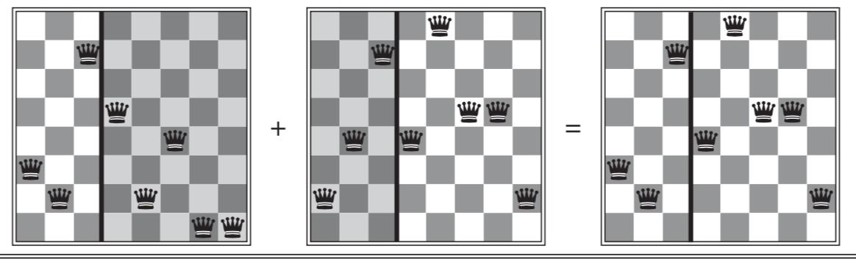
GA Example (2)

Slide 26
When to Use a GA
Alternate solutions are too slow or overly complicated
Need an exploratory tool to examine new approaches
Problem is similar to one that has already been successfully solved by using a GA
Want to hybridize with an existing solution
Benefits of the GA technology meet key problem requirements

Slide 27
Advantages of GA
Perform a “global” search in the search space
Work with a population of individuals (candidate solutions), rather than with just one candidate solution at a time)
Avoid the use of “greedy” heuristics (e.g., start at a given city and visit one city at a time, choosing the nearest city at each step)
Represent a candidate solution in a declarative way, independent of the method used to search for a solution, so they allow the easy specification of constraints on the type solutions to be found
Easy to implement

Slide 28
Benefits of GA
Concept is easy to understand
Modular, separate from application
Supports multi-objective optimization
Good for “noisy” environments
Always an answer; answer gets better with time
Inherently parallel; easily distributed

Slide 29
Disadvantages of GA
Do not offer any guarantee of finding the optimal solution, nor any lower bound on the quality of the solutions to be found
Are computationally expensive in large-scale problems
Have several parameters (crossover probability, mutation probabilities, population size, number of generations, etc.) whose “optimization” is not a trivial task

Slide 30
Issues for GA Practitioners
Choosing basic implementation issues:
Representation
Population size, mutation rate, ...
Selection, deletion policies
Crossover, mutation operators
Termination Criteria
Solution is only as good as the evaluation function (often hardest part)

Slide 31
Related Reading
15 Real-World Applications of Genetic Algorithm
https://www.brainz.org/15-real-world-applications-genetic-algorithms/

